Slide 1
Fetal Alcohol Spectrum Disorder
Craig C. Corp, MD
Notes:
This is a conference about ACEs, so why am I doing a presentation on FASD? Well, having a parent on drugs or alcohol is one of the big 10 ACEs that we screen for. Plus, it is the root of many of the other major ACEs. But, it seems to have been off of our radar so far. Plus, it is something I know a bit about. Some years ago I spent nine years as the medical director of the Butte County Center for FASD. At the time, we had the only such diagnostic center between Santa Clara and Portland, because of the extremely high methamphetamine use in that area. Most of those children are also exposed to alcohol, tobacco, and typically marijuana. We had a team that was responsible for evaluating, diagnosing, and educating parents, teachers, and physicians about this condition.

Slide 2

FASD is rare, right?
Notes:
One would think that this is a rare condition. I pretty much never see this diagnosis in a patient’s chart, unless I am the one who put it there, even in patients with classic signs and symptoms. I do see a diagnosis of prenatal drug exposure at times, typically when the child’s mother tested positive for an illicit substance at birth, and the baby subsequently tested positive as well. Alcohol is not one of the things that we test for, so the kids of mother’s who drank heavily without using other drugs are missed. And unless you ask it very specifically, if you ask a mother, if she is alcohol or drugs during pregnancy, a lot of the time they will not include the five or six weeks before they knew they were pregnant.

Slide 3
Not rare at all
FASD is the most common preventable birth defect in the entire world
13% of women report regular alcohol use during pregnancy, 10% reported binge drinking >5 drinks on one occasion
Incidence is not known, estimates for full blown FAS are in the 0.3/1000 range, however FAS is less than 1% of cases of FASD, so overall >3% of the population
Estimates for full blown FAS is a lifetime cost of $2,000,000 per case. Wide range in FASD
Foster care / prison
Notes:
The thing is, it is not rare at all.

Slide 4
16-24 year old women
1:5 had sex which they regretted
1:10 have had at least one episode when they had been unable to remember if they had sex tonight before
Nearly 85% of teen pregnancies are unplanned
Notes:
Although children are born with FASD no matter the mother’s age, it is disproportionately more common the younger than mother is. These are some of the reasons why.

Slide 5
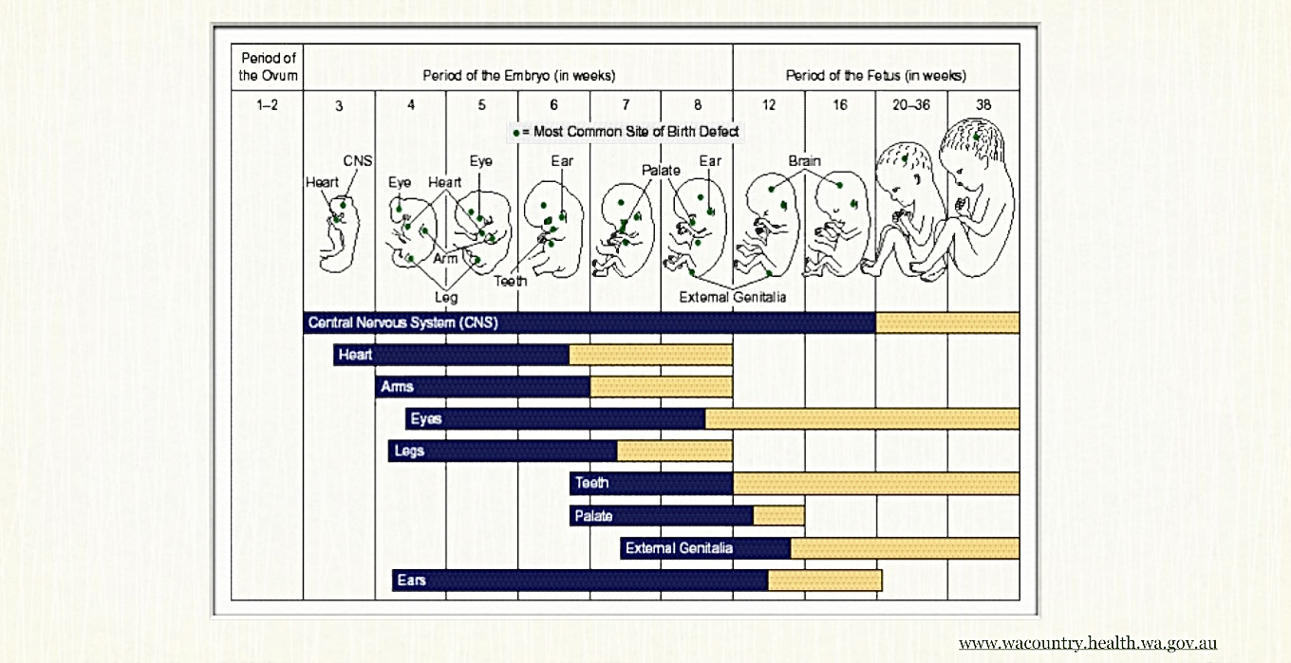
Often the damage is already done
Notes:
Why do those statistics matter?
Well, by the time, a woman who is not intending to become pregnant realizes that she is, it is typically too late to help the developing baby.
Explain graph: top bar – CNSdevelopment from the beginning of the 3rd to end of the 16th week. By the end of the sixth week, which is when many women finally realize they’re pregnant, half of the development of the central nervous system has already occurred.

Slide 6
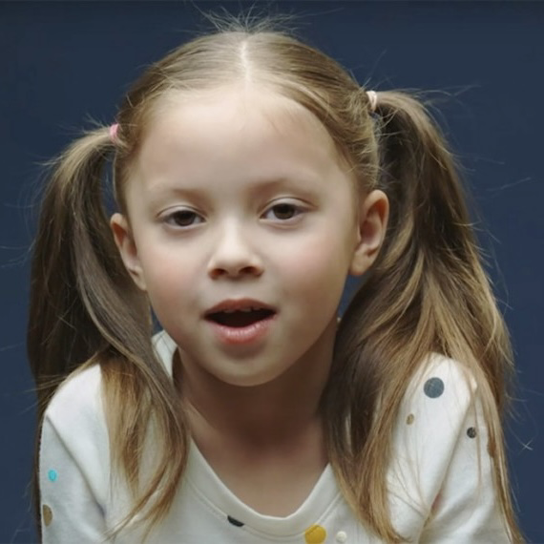
What does it the alcohol do?

Slide 7
Teratogenicity
Abnormal midline apoptosis - Ethanol abnormally activates the pathway used in normal fetal apoptosis.
Brain – leads to size reductions in many specific parts of the brain, less symmetry, change in grey:white matter, ratio, distorted brain shape, and possibly absence of the corpus callosum
Secondary microcephaly
Notes:
Note – WNT is not an acronym, it is a portmanteau of ”wingless” and “int-1”. It is inactivated in 95% of cancers.
Hundreds of millions Central nervous system cells die off inappropriately in the fetus

Slide 8
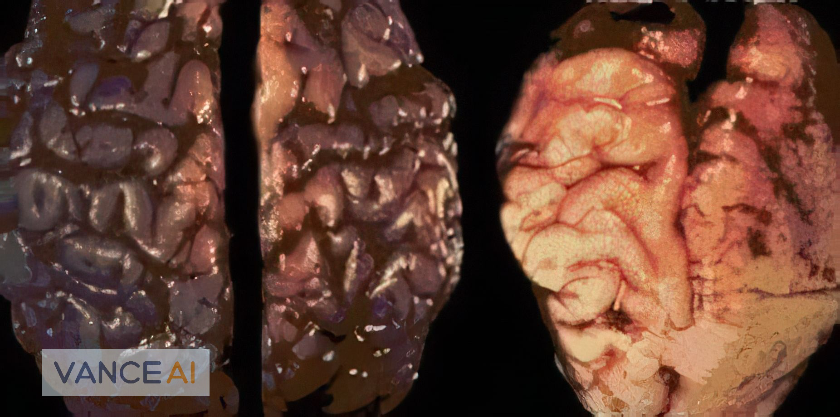
The FASD brain
Notes:
This is clearly an extreme example, but the brain on the left is from a normal six week old. The one on the right is from a six week old with significant prenatal alcohol exposure in the first trimester. Smaller, less complex, abnormal shape, clear midline issues.

Slide 9

Teratogenicity (continued)
Exposure also leads to poor cephalic neural crest cell migration through the nose and philtrum
Under development of the forebrain
Small, wide-spaced, eyes
Flat philtrum
Thin upper lip
Can include cleft lip or palate
<1% meet full facial criteria
Notes:
facial criteria: we used software from the University of Washington where we took a photograph of the patient with a 1 cm round sticker on their forehead as a scale marker. It evaluated eye size, interocular distance, and lip circularity. Philtrum flatness was decided on by manually comparing to visual guides. Out of almost 400 children evaluated in Butte County, only one met all the facial criteria - and she was adopted from Guatemala after being taken away because she was always being left in her mother’s truck while she was drinking in bars every night. We even had one child with seizure and documented absence of the corpus callosum and a couple with cleft lips who didn’t meet full facial criteria
Remember diagnosis of exclusion – Williams Syndrome, Cornelia De Lange, Velocardial-facial

Slide 10
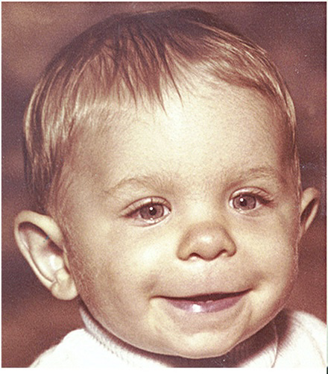
So, what are these kids like?

Slide 11
Effects of prenatal alcohol exposure
Growth: microcephalic, growth failure
Neonate: withdrawal syndrome – disturbed sleep patterns, hyper–reactivity, high activity level, G.I. problems
Infancy: mild gross motor problems, fine motor problems (grasp), developmental delay, language delay, sensory integration and processing issues(can be both sensory seeking and sensory avoidant), prone to sensory overload
Notes:
Sensory example: the child may constantly be trying to drive up the noise and activity in their environment, but after driving the noise and activity level up, but, then they get overloaded and shut down
They may avoid eating foods with certain textures, make their parents take the tags out of all their shirts, only want to wear their socks inside out, and not wanting to wear shoes or clothes for that matter for example
Sensory overload – crowds, driving, noises, lights, etc. They literally cannot filter anything out. Unsuspecting adoptive or foster parents become prisoners in their own homes by age 4 or 5 as they scream from getting ready to leave the house until they get home
For older children and cars, sound muffling headphones, dark, sunglasses, and a pilot badge to make it all fun.

Slide 12
Effects (continued)
Preschool and school age: intellectual deficits, “ADHD”/impulsivity , visual-spacial deficits, gross motor problems - especially cross-hemisphere activities, auditory processing disorder that persists, specific learning difficulties (math), specific memory problems, generally need IEPs with pull out help
Overall going forward: extremely mentally and emotionally, immature, aggressive, overly trusting (gullible), easily manipulated, perseverate a lot, severe executive functioning deficits (can’t put together cause-and-effect)
Notes:
ADHD: this is more of an arousal set-point problem and not necessarily dopamine or norepinephrine mediated, so ADHD medications often don’t help much. Good days and bad days, can tell from moment they wake up
What appears to be impulsivity, as often a severe lack of executive functioning. They cannot put together cause and effect. They are the ones who still run out to the streets into traffic, even after being chastised for it a dozen times.
AT END
You can imagine why it is estimated that somewhere between 35 and 70% of our prison population has prenatal alcohol and/or drug affects.

Slide 13
Effects (continued 2)
Adolescence: lots of problems with academic achievement, vocational/occupational skill deficits, early sexual debut, and risky sexual behaviors
These issues persist into adulthood: those with significant effects often times cannot hold down a job, relationship issues, mental illness, cannot manage their own money, often wind up in dependent living, get taken advantage of or do something without thinking and get in trouble with the law, increased risk of alcohol and substance abuse
Al of those are in children taken away at birth. Those left with biologic parents for any length of time have high ACE scores, often severe reactive attachment disorder
Notes:
ADULTHOOD
job(poor problem-solving skills)
relationship issues (cannot conform to social norms, and inappropriate sexual behavior/promiscuity
It is estimated that anywhere from 30-70% of our prison population has fetal alcohol and/or drug effects

Slide 14
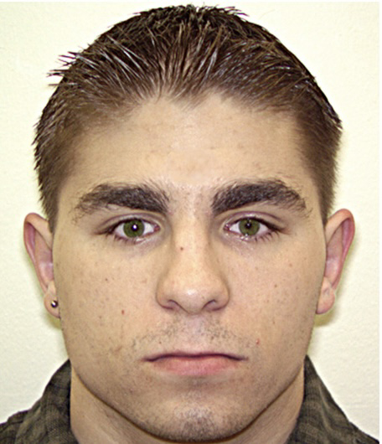
What can we do to help?
Notes:
© Copyright Showeet.com – Creative & Free PowerPoint Templates

Slide 15
Accommodate them!
Of course, continue to work on preventing ACEs - that will reduce the number of these children going forward
Never forget that these children have brain damage – stop pathologizing their behaviors at home and at school
Trying differently rather than harder, Diane Malbin
Notes:
We need to change the paradigm
What looks like a very dysfunctional seven-year-old, may in fact be a perfectly functional 3-year-old. If you treat them their actual age, rather than their biological one, life goes much much better.
“ if you beat a blind child daily for not reading the blackboard, they will develop defensive behaviors, they will become anxious and depressed, they will not want to attend or even hate school. So, we are setting them up for failure I not being realistic “
School: appropriate, simplified learning environment, reduce chances of failure or making wrong choices. Monitor arousal after having learned how to identify a calm – alert, state and teach in calm –alert states
Unfortunately, what I do see is: They get mainstreamed except for special pull out classes. In the regular classes they sleep or work on the homework from their pull out sessions because they cannot understand anything in the regular class.

Slide 16
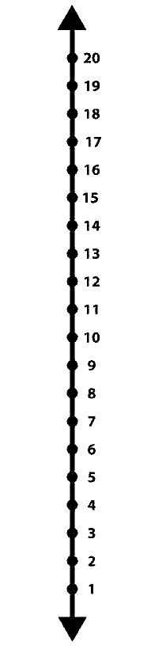
Accommodation (2)
Mathematics Interactive Learning Environment (MILE) study
  Graph paper
  Vertical number line for addition, subtraction
  Focus on relevant math: money, restaurant, grocery store and cooking, etc.
Notes:
MILE study – simple accommodations can make a big difference

Slide 17
What else works?
Educate parents and teachers about FASD
Parent support groups
UCLA “Brain Buddies” - friendship training
ALERTprogram.com – teach does how it feels to be in a quiet/alert state, and how to get back into it if not
Prevention – interventions to pregnant women by OB or PCP, WIC nutritionists, etc
Better yet – include in all birth control counseling (Project CHOICES)
Notes:
Education is critical
Brain buddies: 12 weeks intervention, targeting play and social skills. Those improved by 78% and problem behaviors decreased by 68% per parents and teachers. Measures of self-esteem an self- image improved.
ALERT program initially developed for children with ADHD-uses a car analogy to teach

Slide 18
Meds are a last result
Can try therapy, but often the children can’t really benefit from it because of the brain damage.
We need to learn to not add meds until we are sure that the underlying roots of the condition are fixed as well as they can be
Depression and anxiety – SSRI’s or SSNRI’s. Anger, aggression, tantrums – medium potency antipsychotics . Mood dysregulation – can try valproate or carbamazepine prior to atypical antipsychotic.

Slide 19
Other prenatal exposures
Cannabis: the ABCD study (which looked at childhood outcomes in those with prenatal marijuana exposure)
  In women who stopped when they found out they were pregnant:
    PLEs and internalizing, externalizing, attention, thought and, social problems
    sleep problems and body mass index, as well as lower cognition and gray matter volume
  Only in women who drank throughout pregnancy:
    lower birth weight and total intracranial and white matter volumes

Slide 20
Keep it in mind, so you know how to help
Notes:
© Copyright Showeet.com – Creative & Free PowerPoint Templates

